Slide 1

Python for QA
Python Intermediate

Slide 2
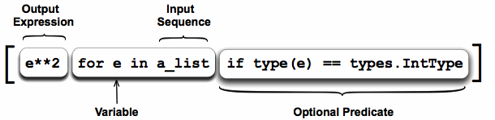
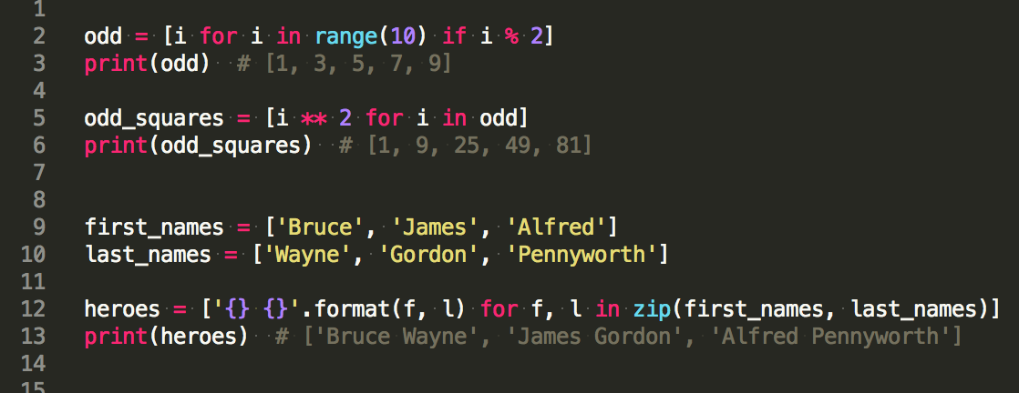
List Comprehension
List comprehension is an elegant way to define and create list in Python.
Notes:
get example from here

Slide 3
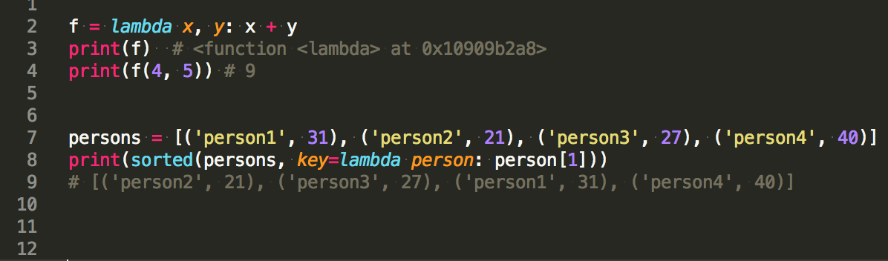
Lambda Expressions
Anonymous functions are created using lambda keyword.
Notes:
example with sorted

Slide 4

Functional Programming Tools
map()
filter()
reduce()
Notes:
Example - remove empty elements from list

Slide 5
Practice
Generate list with integers divisible by 5 using:
List comprehension
Filter function
Apply transformation items in list
Multiple all numbers in list
Notes:
2. >>> users = [('anna', 21), ('petro', 34), ('ivan', 55)]
>>> map(lambda x: (x[0], x[1] + 1), users)
[('anna', 22), ('petro', 35), ('ivan', 56)]
3.

Slide 6

Modules and Packages
Standard modules:
sys
os
collections
Packages
__init__.py
Import
import sys.argv
from sys import argv
Notes:
Example with Counter

Slide 7
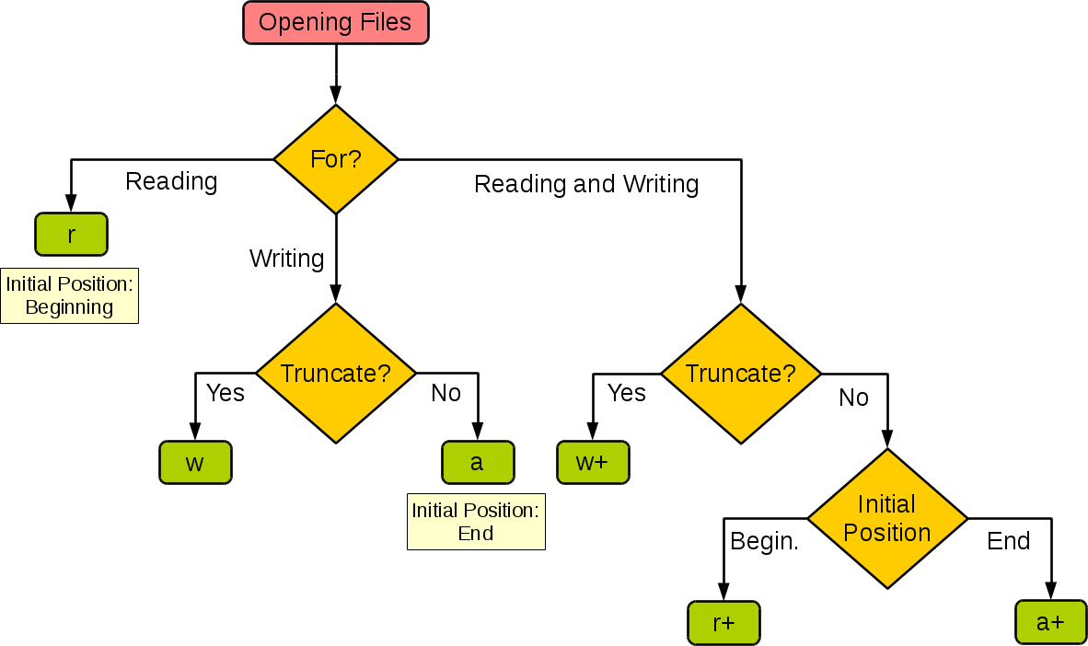
Files
open(file_name, mode) - returns file object
File object methods:
close()
read()
readline()
seek()
write()
writelines()
Notes:
https://docs.python.org/2/tutorial/inputoutput.html
writelines accepts sequence, write - str
use context manager

Slide 8
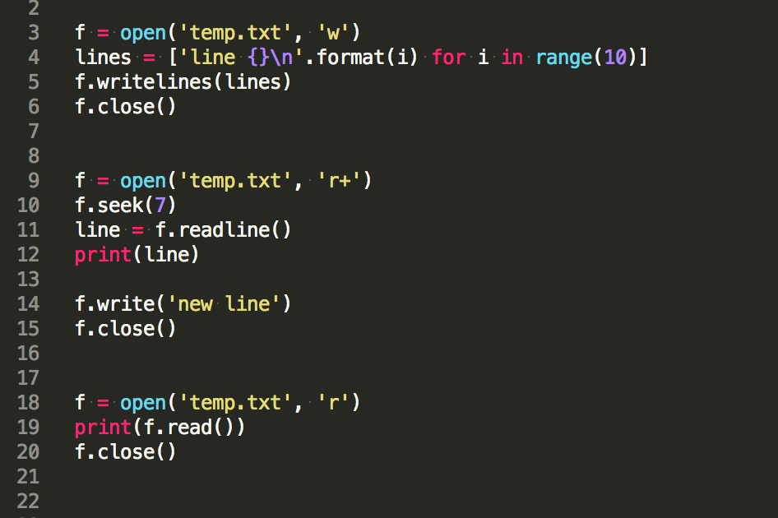
Read and Write Example
Notes:
https://docs.python.org/2/tutorial/inputoutput.html
writelines accepts sequence, write - str
use context manager

Slide 9
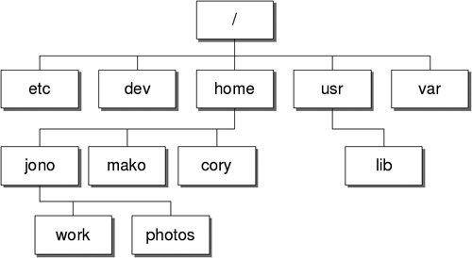
File and Directory Access
os.path
dirname
exists
join
walk
filecmp
cmp
cmpfiles
shutil
copy
rmtree
move
make_archive
Notes:
https://docs.python.org/2/library/filesys.html

Slide 10
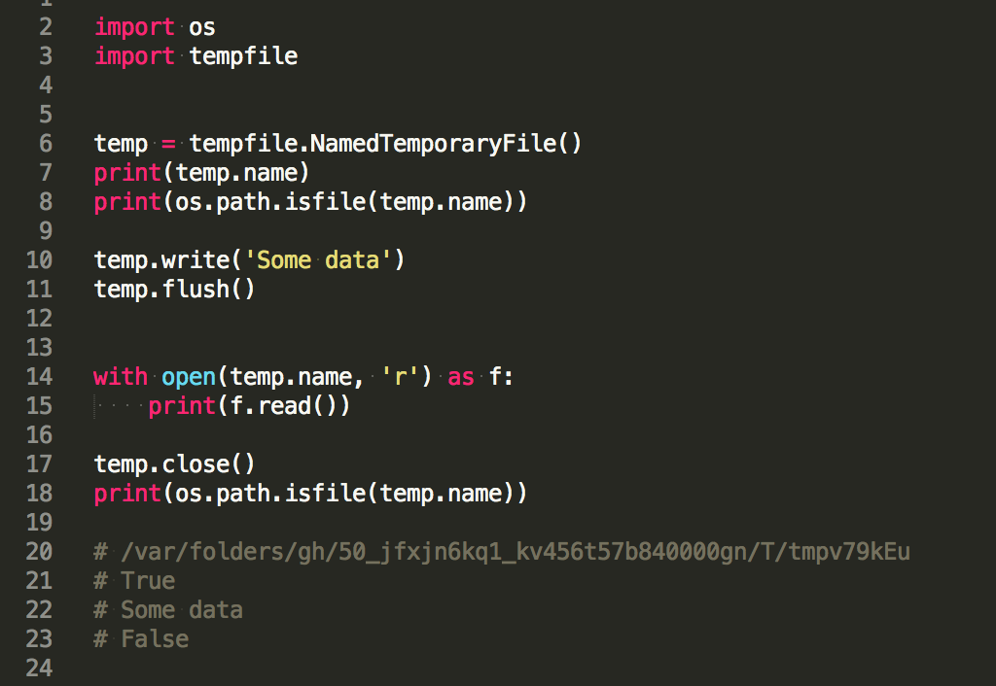
Tempfile
tempfile.TemporaryFile
tempfile.NamedTemporaryFile
Notes:
write and read example
https://docs.python.org/2/library/tempfile.html

Slide 11
Exceptions
An exception is an event, which occurs during the execution of a program, that disrupts the normal flow of the program's instructions:
ZeroDivisionError
NameError
TypeError
ValueError
IndexError
IOError
Notes:
Type error - 5 + 'a'
Value error - int('10.234')

Slide 12
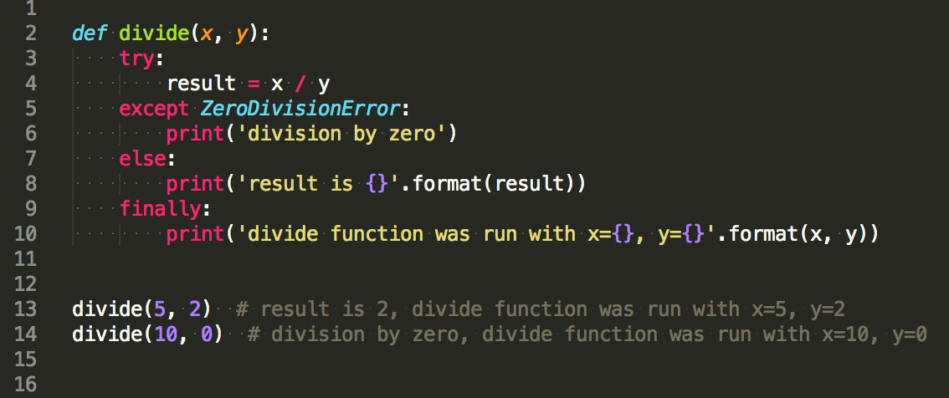
Exceptions Handling
try:
# operations here
except TypeError:
# case if TypeError was raised in try block
except ValueError as e:
# case if TypeError was raised in try block, exception is assigned to e
else:
# optional, exception wasn't raised in try block
finally:
# optional, execute this block in any case

Slide 13
With Statement
try:
f = open('integers.txt', 'r')
s = f.readline()
i = int(s.strip())
print(i)
except ValueError:
print('No valid integer in line.')
finally:
f.close()
with open('integers.txt', 'r') as f:
try:
s = f.readline()
i = int(s.strip())
print(i)
except ValueError:
print('No valid integer in line.')
Notes:
VS example

Slide 14
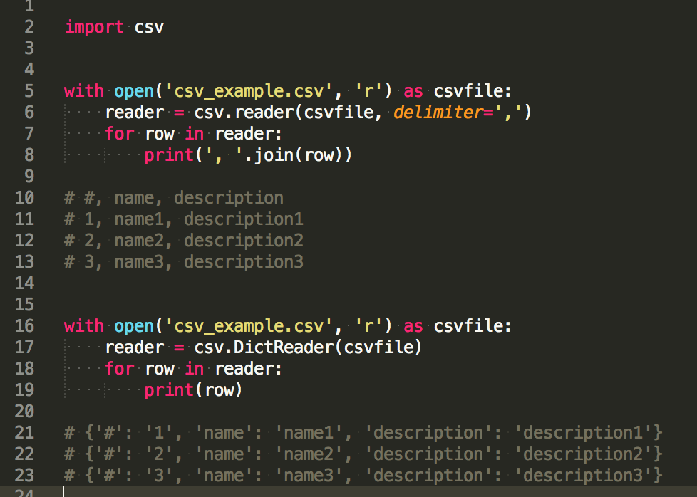
CSV Read
csv readers
csv.reader
csv.DictReader
Notes:
Example without headers + use different separator

Slide 15
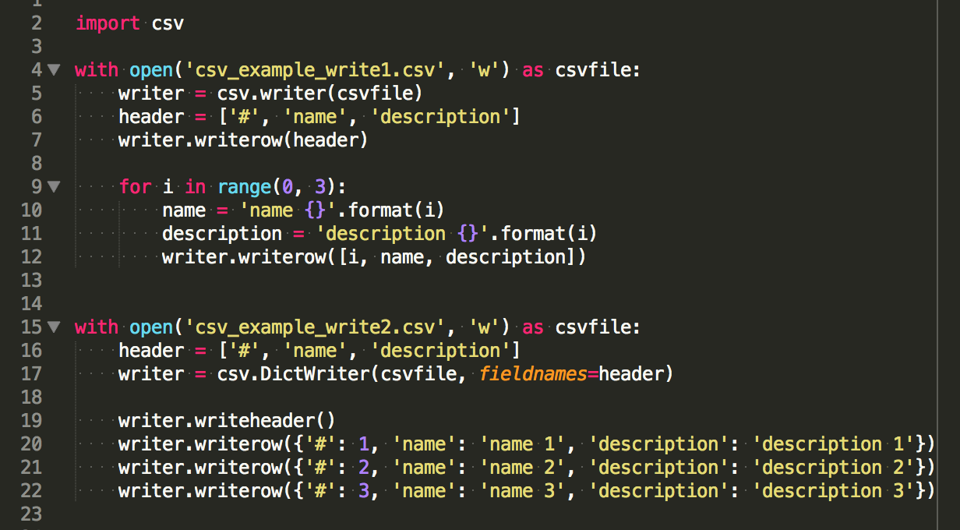
CSV Write

Slide 16
Practice
Import standard modules
Get full path to file
Copy directory and remove origin
File read/write
Use temporary file
CSV read/write
Notes:
Open file from the same folder as python file

Slide 17

Working with Date and Time
date
datetime
timedelta
Notes:
https://docs.python.org/2/library/datetime.html

Slide 18
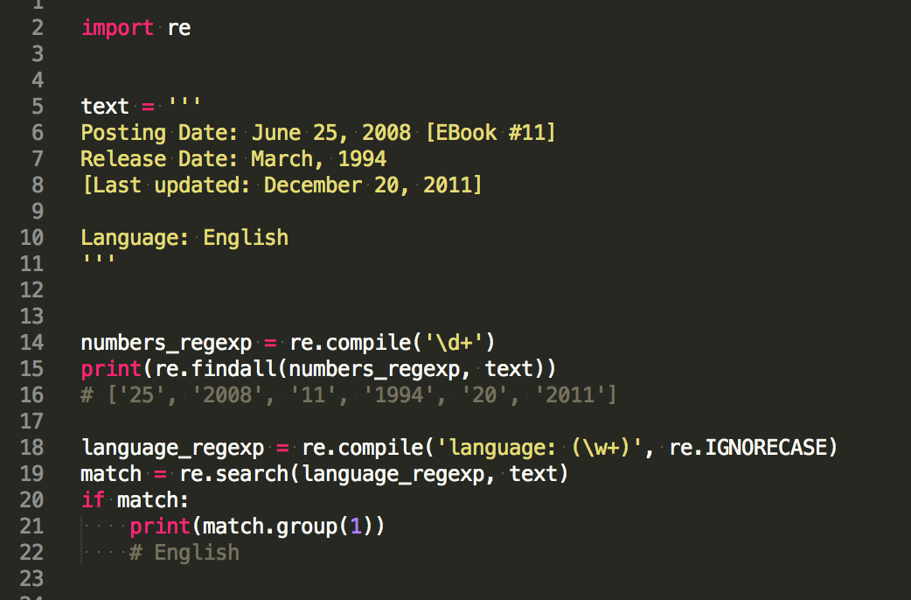
Regular Expressions
re
compile()
search()
match()
split()
findall()
sub()
flags
re.IGNORECASE
re.MULTILINE
Match Object
group()
groups()
Notes:
https://docs.python.org/2/library/re.html
Re.sub - all matches, but could specify count for limit

Slide 19
Practice
Get current date
Print data in ISO and user specified formats
Parse date from string
Add two days to date
Get current UTC time
Find all occurrences using regular expression
Match string
Substitute matching regexp

Slide 20
Summary

Slide 21
Keywords
lambda
sorted
map
filter
reduce
open
import
csv
tempfile
try … except
with
os
datetime
re
shutil

Slide 22
Practice
Write script to process Nginx log file.
Convert logs to CSV with columns:
ip
date
time
HTTP method
URL
response status code
Dates should be converted to UTC
Use temporary file as storage
Copy result to current directory only if convert process finished successfully

Slide 23
Useful
Modules
Input and Output
List Comprehension
Exceptions
CSV
Tempfile
Datetime
Regular Expressions

Slide 24
Homework
Solve nexts tasks.
Level 1 - 1 point
Level 2 - 2 points
Level 3 - 4 points
Please create task*.py file for each problem solution in directory lesson3, where * is task number.

Slide 25
Questions?

